Slide 1

Collision Detection
CSE 191A: Seminar on Video Game Programming
Lecture 3: Collision Detection
UCSD, Spring, 2003
Instructor: Steve Rotenberg

Slide 2
Collision Detection
Geometric intersection detection
Main subjects
  Intersection testing
  Optimization structures
  Pair reduction

Slide 3
Intersection Testing

Slide 4
Intersection Testing
General goals: given two objects with current and previous orientations specified, determine where and when the two objects will first intersect
Alternative: given two objects with only current orientations, determine if they intersect
Sometimes, we need to find all intersections. Other times, we just want the first one. Sometimes, we just need to know if the two objects intersect and don’t need the actual intersection data.

Slide 5
Triangle Normals
n=(v₁-v₀)×(v₂-v₀)
Length of n is twice the area of the triangle (ABsinθ)
v₂
v₂-v₀
n
v₁
v₀
v₁-v₀

Slide 6
Segment vs. Triangle
Does segment (ab) intersect triangle (v₀v₁v₂) ?
First, compute signed distances of a and b to plane
d_{a}=(a-v₀)·n d_{b}=(b-v₀)·n
Reject if both are above or both are below triangle
Otherwise, find intersection point
x=(b*d_{a}-a*d_{b})/(d_{a}-d_{b})
a
x
b

Slide 7
Segment vs. Triangle
Is point x inside the triangle?
(x-v₀)·((v₂-v₀)×n) > 0
Test all 3 edges
v₂
v₂-v₀
x-v₀
x
v₀
v₁
(v₂-v₀)×n

Slide 8
Faster Way
Reduce to 2D: remove smallest dimension
Compute barycentric coordinates
x' =x-v₀
e₁=v₁-v₀
e₂=v₂-v₀
α=(x'×e₂₎/(e₁×e₂)
β=(x'×e₁₎/(e₁×e₂)
Reject if α<0, β<0 or α+β >1
v₂
β
x
v₀
α
v₁

Slide 9
Segment vs. Mesh
To test a line segment against a mesh of triangles, simply test the segment against each triangle
Sometimes, we are interested in only the ‘first’ hit. Other times, we want all intersections.
We will look at ways to optimize this later

Slide 10
Segment vs. Moving Mesh
M₀ is the object’s matrix at time t₀
M₁ is the matrix at time t₁
Compute delta matrix:
M₁=M₀·M_{Δ}
M_{Δ}= M₀⁻¹·M₁
Transform A by M_{Δ}
A'=A·M_{Δ}
Test segment A'B against object with matrix M₁

Slide 11
Triangle vs. Triangle
Given two triangles: T₁ (u₀u₁u₂) and T₂ (v₀v₁v₂)
v₂
u₂
v₀
T₂
T₁
u₀
v₁
u₁

Slide 12
Triangle vs. Triangle
Step 1: Compute plane equations
n₂=(v₁-v₀)×(v₂-v₀)
d₂=-n₂·v₀
v₂
v₂-v₀
n
v₁
v₀
v₁-v₀

Slide 13
Triangle vs. Triangle
Step 2: Compute signed distances of T₁ vertices to
plane of T₂:
d_{i}=n₂·u_{i}+d₂ (i=0,1,2)
Reject if all d_{i}<0 or all d_{i}>0
Repeat for vertices of T₂ against plane of T₁
u₀
d₀

Slide 14
Triangle vs. Triangle
Step 3: Find intersection points
Step 4: Determine if segment pq is inside triangle or intersects triangle edge
q
p

Slide 15
Mesh vs. Mesh
Geometry: points, edges, faces
Collisions: p2p, p2e, p2f, e2e, e2f, f2f
Relevant ones: p2f, e2e (point to face & edge to edge)
Multiple collisions

Slide 16
Moving Mesh vs. Moving Mesh
Two options: ‘point sample’ and ‘extrusion’
Point sample:
  If objects intersect at final positions, do a binary search backwards to find the time when they first hit and compute the intersection
  This approach can tend to miss thin objects
Extrusion:
  Test ‘4-dimensional’ extrusions of objects
  In practice, this can be done using only 3D math

Slide 17
Moving Meshes: Point Sampling
Requires instantaneous mesh-mesh intersection test
Binary search

Slide 18
Moving Meshes: Extrusion
Use ‘delta matrix’ trick to simplify problem so that one mesh is moving and one is static
Test moving vertices against static faces (and the opposite, using the other delta matrix)
Test moving edges against static edges (moving edges form a quad (two triangles))

Slide 19
Convex Geometry: V-Clip
Tracks closest features
Fails when objects intersect
Requires pairwise updates

Slide 20
Box vs. Box
Separating Axis Theorem
  If boxes A and B do not overlap, then there should exist a separating axis such that the projections of the boxes on the axis don’t overlap. This axis can be normal to the face of one object or connecting two edges between the two objects.
  Up to 15 axes must be tested to check if two boxes overlap

Slide 21
Triangle vs. Box
Test if triangle is outside any of the 6 box planes
Test if the box is entirely on one side of the triangle plane
Test separating axis from box edge to triangle edge

Slide 22
Intersection Issues
Performance
Memory
Accuracy
Floating point precision

Slide 23
Optimization Structures

Slide 24
Optimization Structures
BV, BVH (bounding volume hierarchies)
Octree
KD tree
BSP (binary separating planes)
OBB tree (oriented bounding boxes- a popular form of BVH)
K-dop
Uniform grid

Slide 25
Testing BVH’s
TestBVH(A,B) {
if(not overlap(A_{BV}, B_{BV}) return FALSE;
else if(isLeaf(A)) {
if(isLeaf(B)) {
for each triangle pair (T_{a},T_{b})
if(overlap(T_{a},T_{b})) AddIntersectionToList();
}
else {
for each child C_{b} of B
TestBVH(A,C_{b});
}
}
else {
for each child C_{a} of A
TestBVH(C_{a},B)
}
}

Slide 26
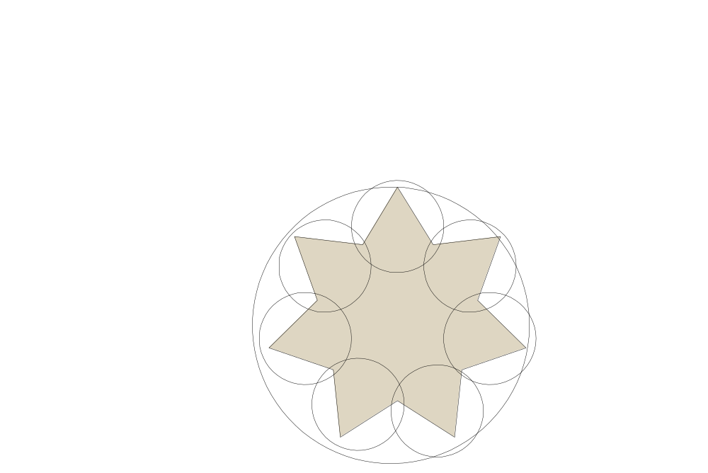
Bounding Volume Hierarchies

Slide 27
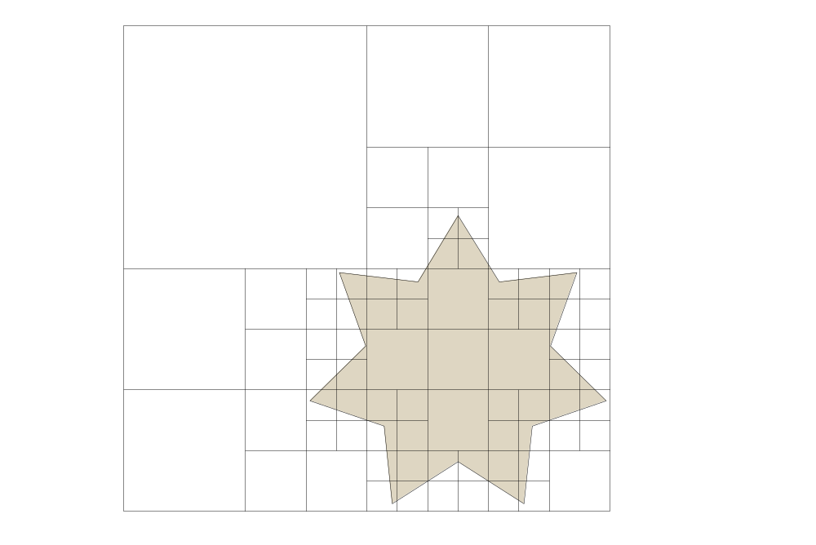
Octrees

Slide 28
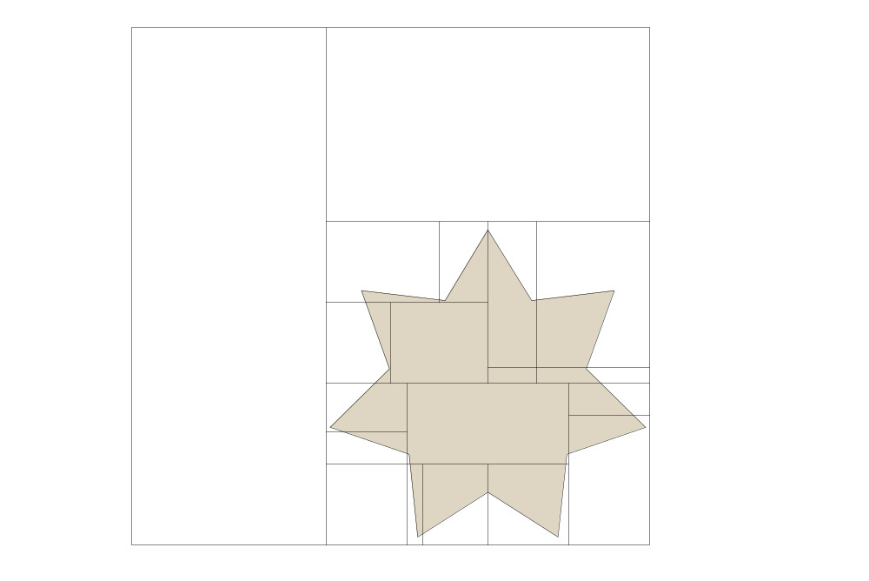
KD Trees

Slide 29
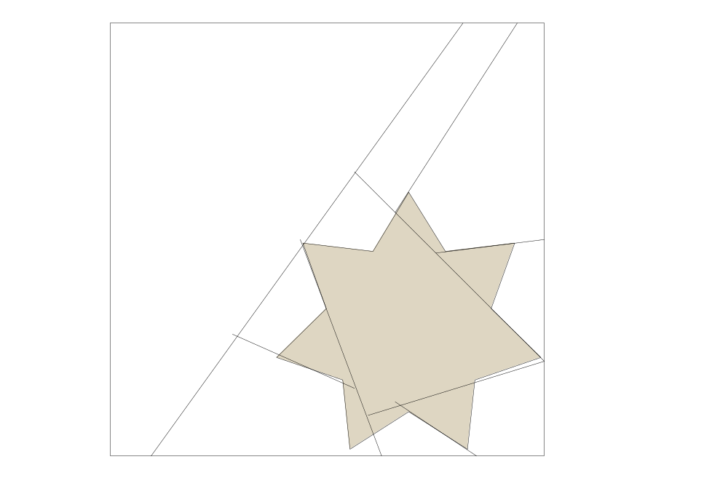
BSP Trees

Slide 30

OBB Trees

Slide 31
K-Dops

Slide 32

Uniform Grids

Slide 33
Optimization Structures
All of these optimization structures can be used in either 2D or 3D
Packing in memory may affect caching and performance

Slide 34
Pair Reduction

Slide 35
Pair Reduction
Reduce number of n^2 pair tests
Pair reduction isn’t a big issue until n>50 or so…

Slide 36
Uniform Grid
All objects are tracked by their location in a uniform grid
Grid cells should be larger than diameter of largest object’s bound sphere
To check collisions, test all objects in cell & neighboring cells
Hierarchical grids can be used also

Slide 37
Hashing Grid
Cells don’t exist unless they contain an object
When an object moves, it may cross to a new cell

Slide 38
Conclusion

Slide 39
Preview of Next Week
Physics
  Particles
  Rigid bodies
  Vehicles

Slide 40
Reading Assignment
“Real Time Rendering”
  Chapter 14

